Slide 1

Social issues
By Jaffar and Haseeb Ali

Slide 2

Top 5 Current Major Social issues in India in 2022
Corruption
Basic Sanitation
Pollution
Poverty
Unemployment

Slide 3
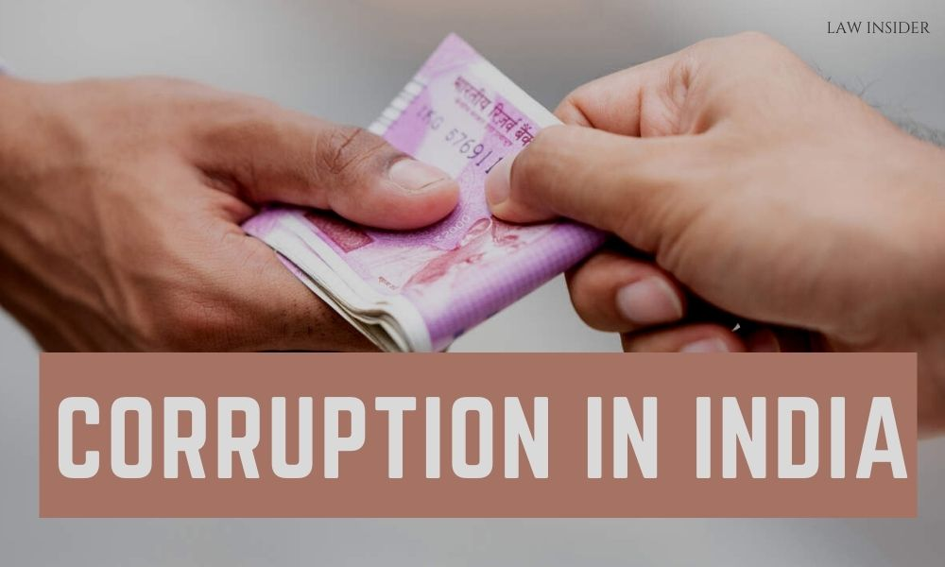
Corruption...
Corruption is Fraudulent conduct by those in power. Corruption in India is a result of the connection between bureaucrats, politicians and criminals bribes were paid for getting wrong things done, but now bribe is paid for getting right things done at right time.
Causes of Corruption
Greed of money, desires.
Higher levels of market and political monopolization
Low levels of democracy, weak civil participation and low political transparency
Higher levels of bureaucracy and inefficient administrative structures

Slide 4

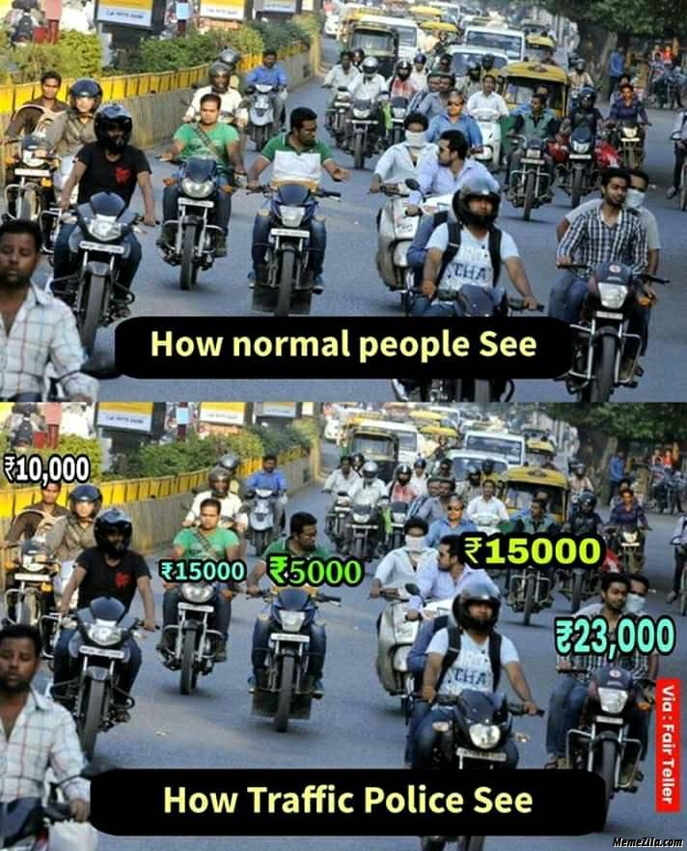
Cause of police corruption :
"Corruption can be stop by curing the mind of it rather that fighting it directly'

Slide 5

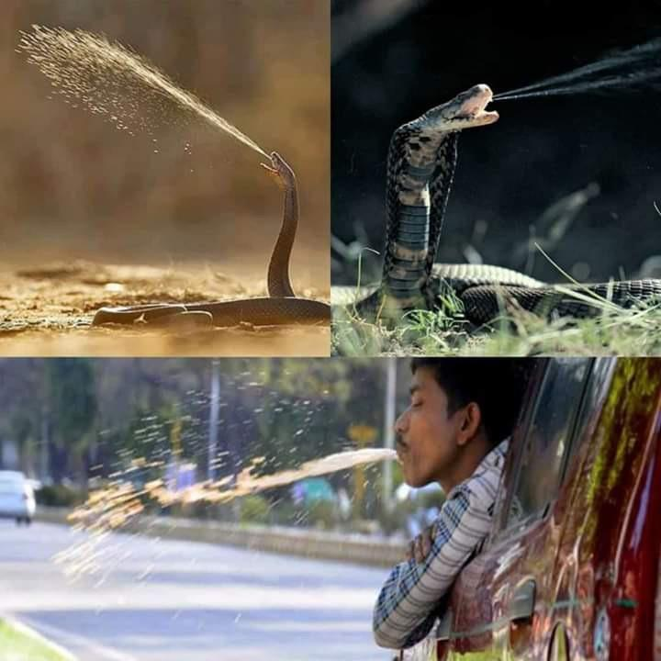
Basic sanitation
uneven distribution of precipitation and demographic density cause issues. Due to the lack of appropriate access to clean water and related infrastructures such as toilets and other resources.
Causes of lack of basic sanitation:
Lack of adequate and appropriate toilets.
Mental and societal reasons determine the preference for open defecation
Limited water access in rural regions and supply is the cornerstone of the sanitation system

Slide 6
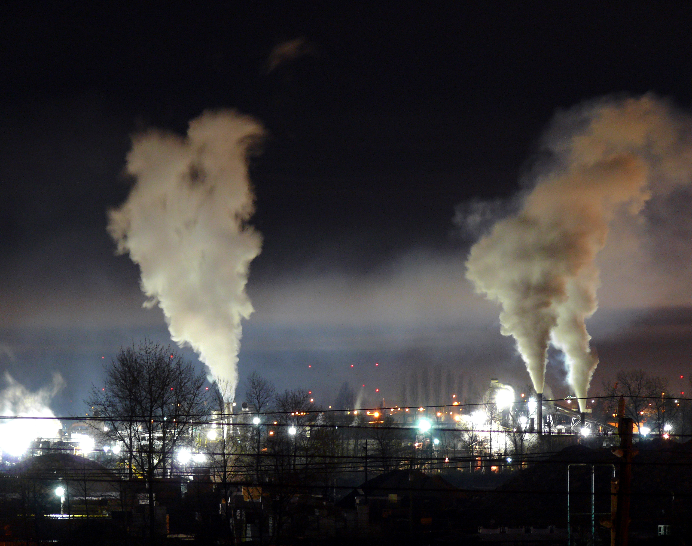
Pollution..
Pollution is the introduction of harmful materials into the environment. These harmful materials are called pollutants. Pollutants can be natural, such as volcanic ash. They can also be created by human activity, such as trash or runoff produced by factories. Pollutants damage the quality of air, water, and land.
There are mainly 3 type of pollution
This Photo by Unknown author is licensed under CC BY-SA.

Slide 7

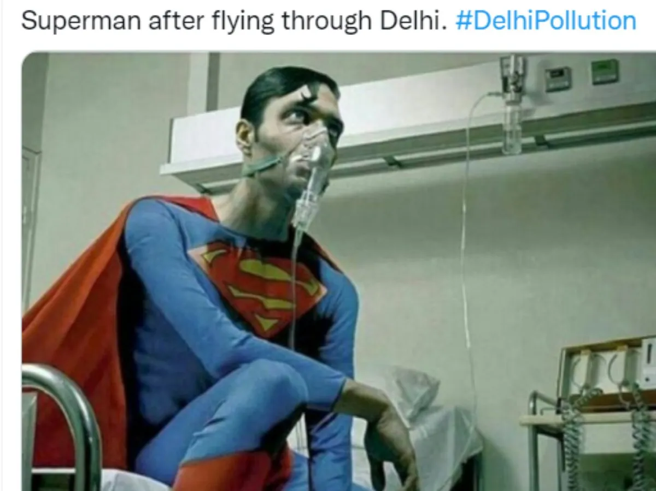
1.Air Pollution
(Effect on superheroes in India)
Causes due to :-
The Burning of Fossil Fuels
Industrial Emission.
Indoor Air Pollution.
Wildfires.
Microbial Decaying Process.
Open Burning of Garbage Waste.

Slide 8
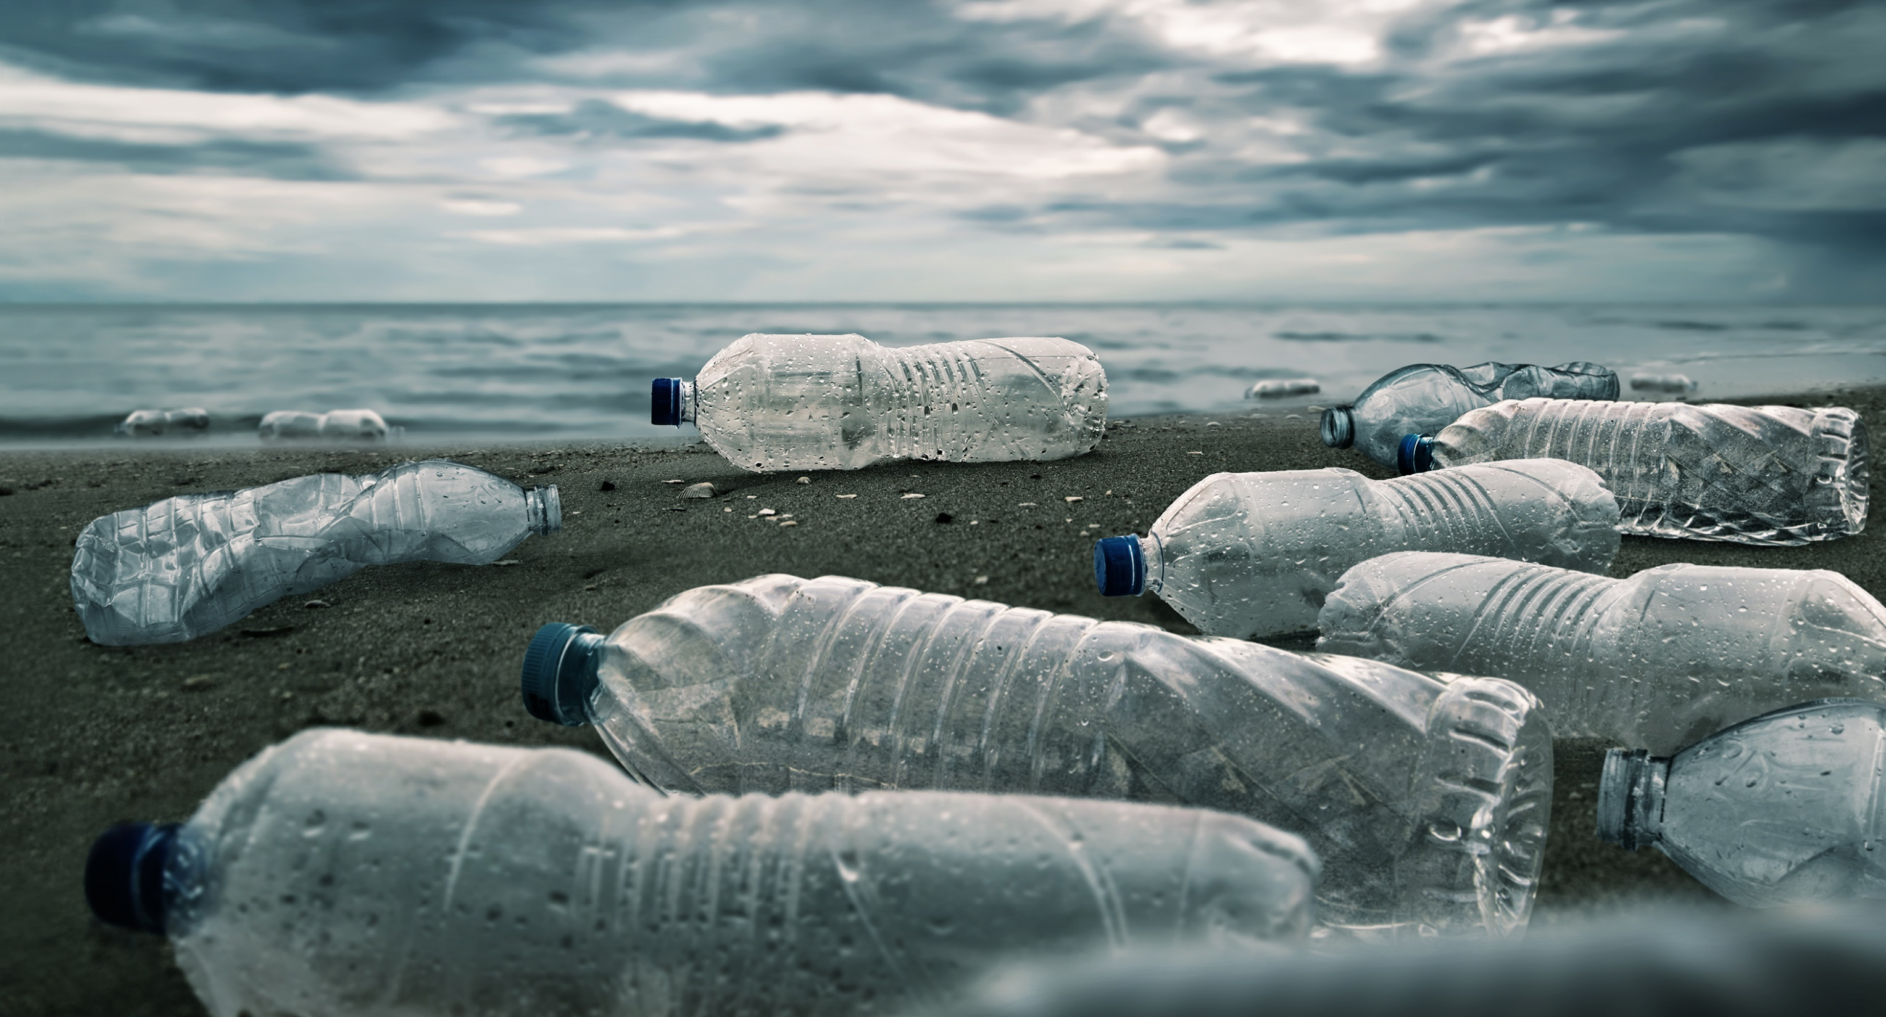
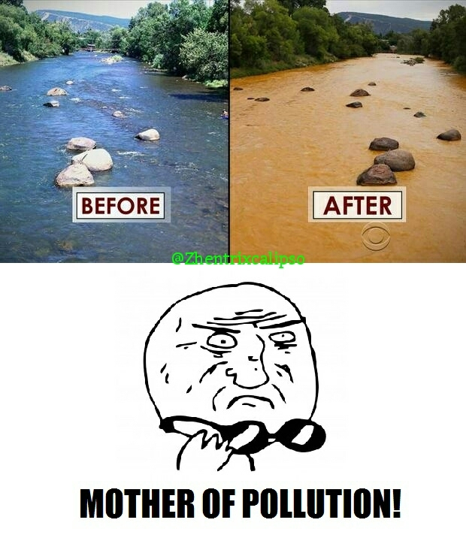
2.Water Pollution
Causes due to :-
Human activities such as littering
Waste washed ashore from boats7
Oil rigs
Sewage treatment plants
Especially due to Indian Cobra’s

Slide 9
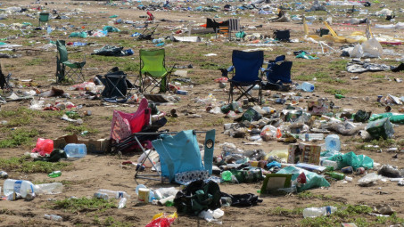
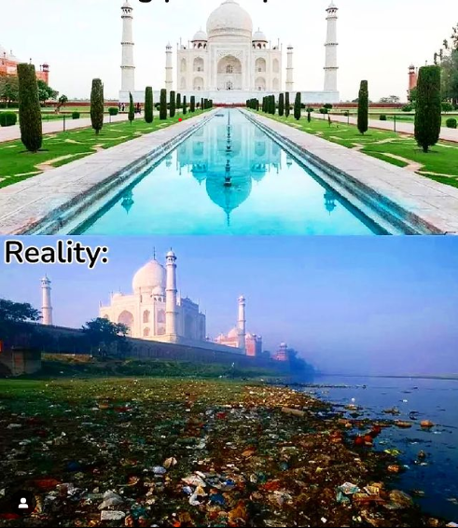
3.Land Pollution
Causes due to:-
Global warming.
Deforestation.
Industry, agriculture and livestock farming.
Rubbish and faecal water dumping.
Fuel spillages.

Slide 10

Poverty
India is a developing nation. Although its economy is growing, poverty is still a major challenge. However, poverty is on the decline in India. According to World Bank, extreme poverty has reduced by 12.3% between 2011 and 2019 and The 2019/2021 data observes that about 16.4 per cent of India's population is poor, out of which 4.2 per cent live in extreme poverty as their deprivation score is more than 50 per cent
Prevention of poverty:-
Eradicating poverty through education
Halting poverty by ending hunger
Cash solves poverty.
This Photo by Unknown Author is licensed under CC BY-NC

Slide 11
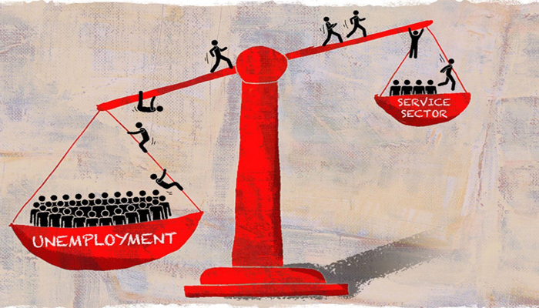
Unemployment (engineering)
Unemployment and under-employment have been a long-standing problem in the Indian economy. According to a 2013 report by Pravin Sinha, the Indian labour force has been officially classified by the Indian government into three categories:
Rural sector, which includes the farm labour
Urban formal sector,which includes factory & service industry labour
Urban informal sector, which includes self-employment and casual wage workers
The rural and informal sectors of the Indian labour market accounted for 93% of the employment in 2011.
New survey was initiated in 2017–2018. This report has not been officially released by the BJP-led Narendra Modi's government 2018-2019 reports According to the Pew Research Center, a significant majority of Indians consider the lack of employment opportunities as a "very big problem" in their country.
This Photo by Unknown Author is licensed under CC BY

Slide 12
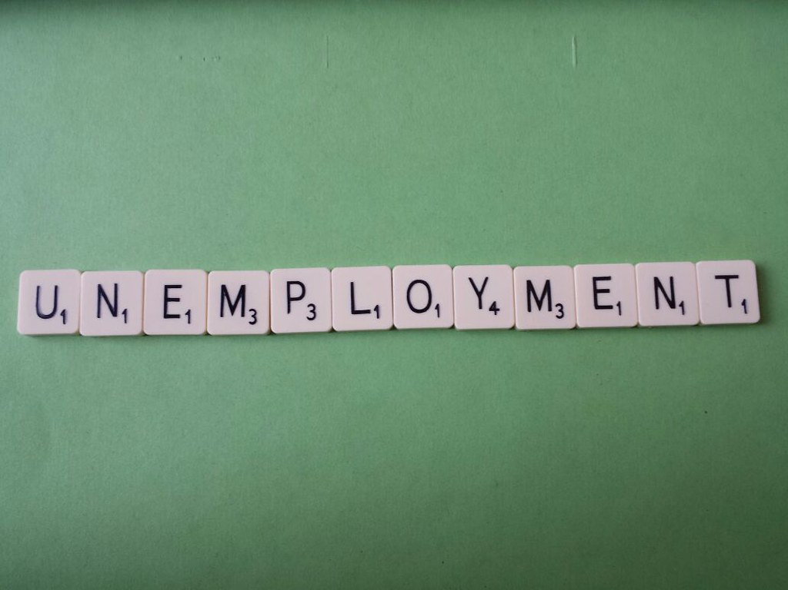
The report states that male youth had an unemployment rate of 17.4% and 18.7% in rural and urban areas, while women youth had rates of 13.6% and 27.2% respectively in 2017-18. However, the think tank of Government of India, NITI Aayog says that these are not official and the data is not yet verified.
Measures taken by government to prevent employment:-
Pradhan Mantri Mudra Yojana (PMMY) is being implemented by the Government for facilitating self-employment. Under PMMY, collateral free loans upto Rs. 10 lakh, are extended to micro/small business enterprises and to individuals to enable them to setup or expand their business activities.
This Photo by Unknown Author is licensed under CC BY

Slide 13


Thank you
Source :
Wikipedia & google

